Slide 1

Realtime anomaly detection for Content delivery proxy logs
Inuwa Amir Usman Aizaz Ali Qureshi Meskine Mouloud Tosayeva Arzu

Slide 2
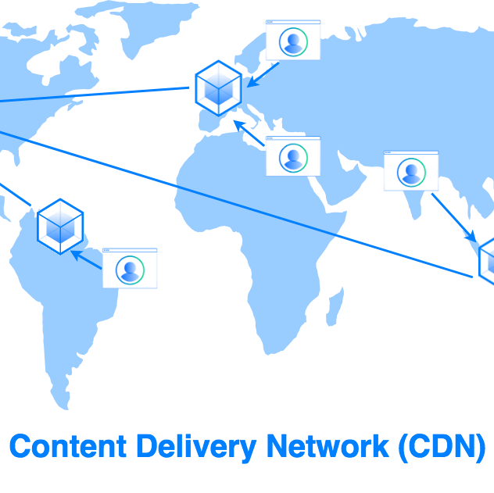
Agenda
Introduction
Objectives
Algorithms
Technologies
Summary

Slide 3
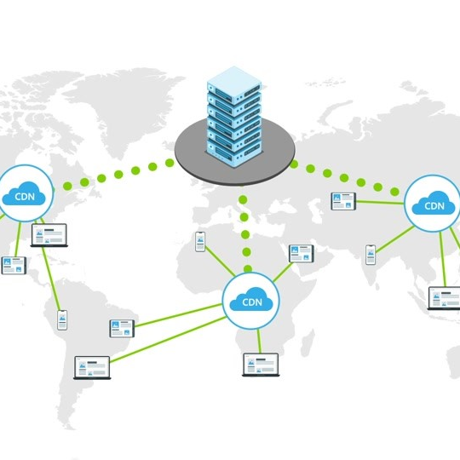
Introduction
A content delivery network (CDN) refers to a geographically distributed group of servers which work together to provide fast delivery of Internet content.
A CDN allows for the quick transfer of assets needed for loading Internet content including HTML pages, javascript files, stylesheets, images, and videos. The popularity of CDN services continues to grow, and today the majority of web traffic is served through CDNs, including traffic from major sites like Facebook, Netflix, and Amazon.

Slide 4
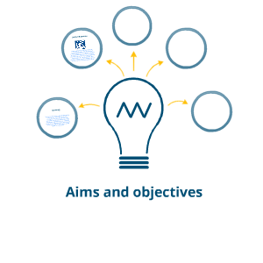
Aims and Objectives
Understanding the dataset and reading related papers
Choosing proper unsupervised algorithms to apply
Use variety of open source technologies
Identify anomalies from real-life proxy logs
Build an anomaly detection system

Slide 5
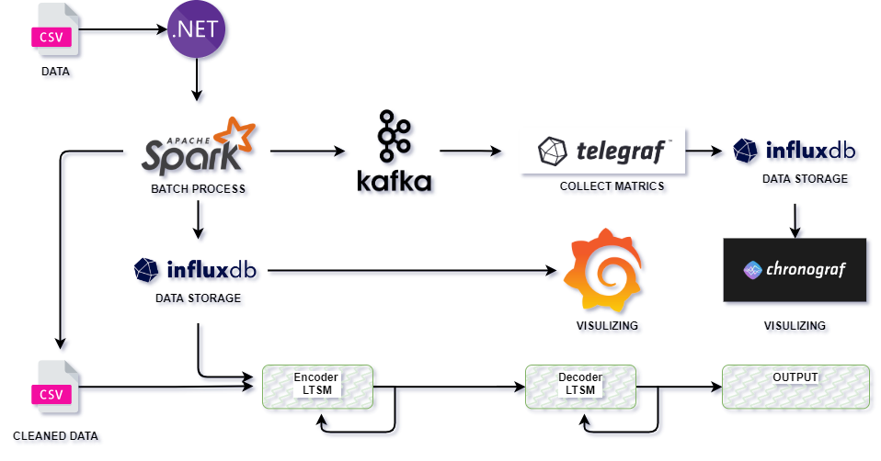
Architecture

Slide 6
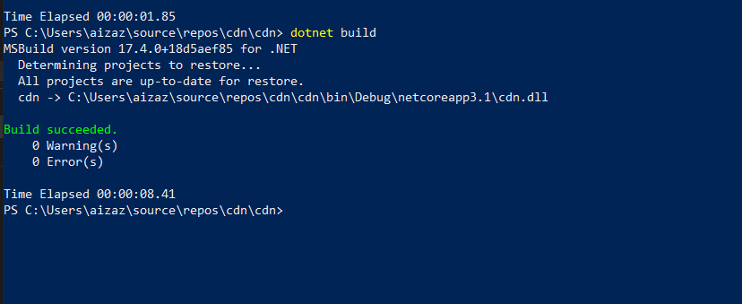
Batch processing with .NET for Apache Spark
Batch processing is the transformation of data at rest, meaning that the source data has already been loaded into data storage, Batch processing is generally performed over large, flat datasets that need to be prepared for further analysis. Log processing and data warehousing are common batch-processing scenarios. In this scenario, we must see how close the server we placed, and finds the anomaly in the data the three main key features @timeStamp and, Time for the first Byte, Time to Server.
First we have done:
Create and run a .NET for Apache Spark application
Read data into a DataFrame and prepare it for analysis
Process the data using Spark SQL

Slide 7
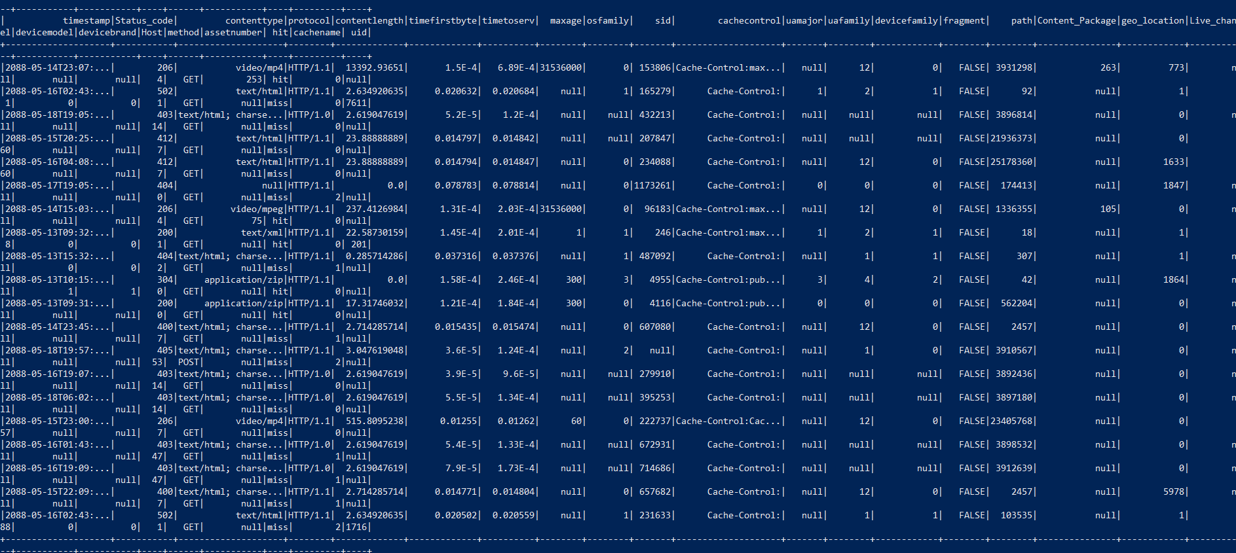
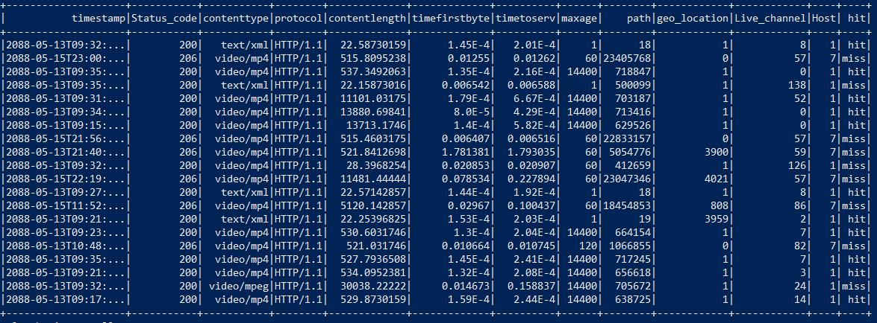
Preparing Data
Initially, we changed the input file into a Data Frame, which is a distributed collection of data structured into named columns. Then, we defined the columns of your data through the Schema parameter. Before describing the schema, we select the delimiter and select the features that are most relevant to find any abnormalities in data e.g., TIMESTAMP, CONTENTYPE, TIME TO FIRST BYTE, TIME TO SEVER, MAXAGE, GEO-LOCATION, ETC.
Further, to delete rows with NA (null) values, use the Na method, and to remove specific columns from data, using the Drop method. This helps you avoid errors when attempting to examine null data or columns that are irrelevant for the final uploading or pipeline with the database.

Slide 8
Data to InfluxDB
Now, for analyzing the data via upload in Time Series Databases such as Influx DB and Grafana for virtualization, setting up docker, and creating a docker-compose file, for Inflex dB, and Grafana dependencies on influx dB via pipelines, we run the docker-compose up to download relevant images.
For analyzing the cleaned data after the batch processing, we create a Python Program that changes the time stamp help of pandas as pd, and for uploading to influx dB we can import influx dB DataFrameClient but must mention the following environment that connects the localhost:8086 and dump the data into influx dB bucket project1db.
Fields and Data Tags
The selection of field values in metadata is the selection of fields same as batch process data but must configure the data tags and fixed tags in python, Besides the timestamp field, each data element consists of various tags (optional, indexed metadata fields), fields (key and value), and measurement (container for tags, fields, and timestamps).

Slide 9
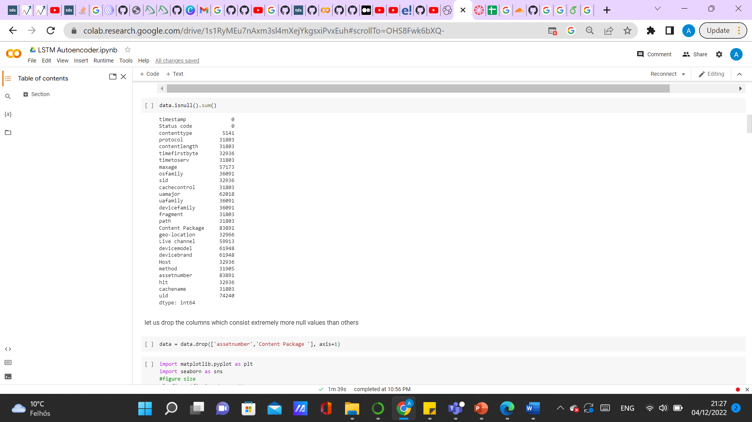
Data Preprocessing
Dataset
This dataset has 27 different features with both numerical and categorical data.
Numerical Features
We have used several techniques to handle null values. For numerical features we used mode to fill null values.
Categorical Features
For categorical features we used one-hot-encoder. The one-hot encoding technique was used to transform the categorical features into numerical values.
Feature Selection
We have used correlation based feature selection. In this technique the linear relationship between variables is analysed and the results indicate the similarity of variables.
Result
As a result we got 14 features which we then used for different implementations.

Slide 10
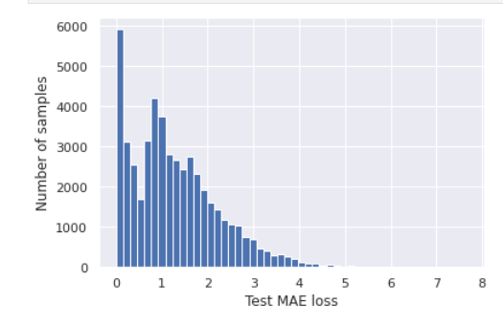
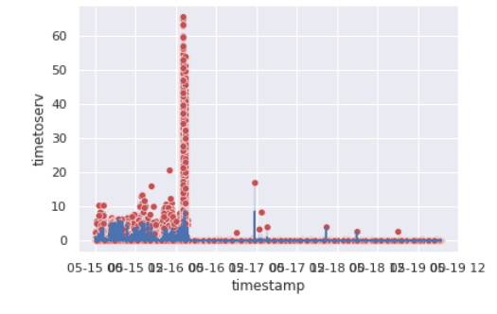
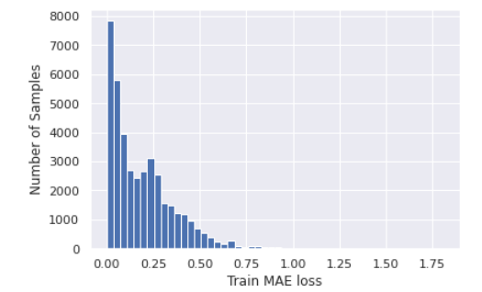
Unsupervised algorithm implementation
We implemented LSTM Autoencoder in terms of detecting anomalies. LSTMs can provide better results than parametric models and standard RNNs when dealing with complex autocorrelation sequences. Train an LSTM autoencoder on data from 2088-05-13 to 2088-05-19 .We assume that there were no anomalies and they were normal.Using the LSTM autoencoder to reconstruct the error on the test data from 2088-05-13 to 2088-05-19. If the reconstruction error for the test data is above the threshold, we label the data point as an anomaly. We used standard scaler and created sequences in terms of time_steps. Dropout value,learning rate,number of epochs, batch size have been used. After all we found MAE loss on the training data and make loss value in the training data as the reconstruction error threshold. If the reconstruction loss for a data point in the test set is greater than this threshold value we label this as anomaly.

Slide 11
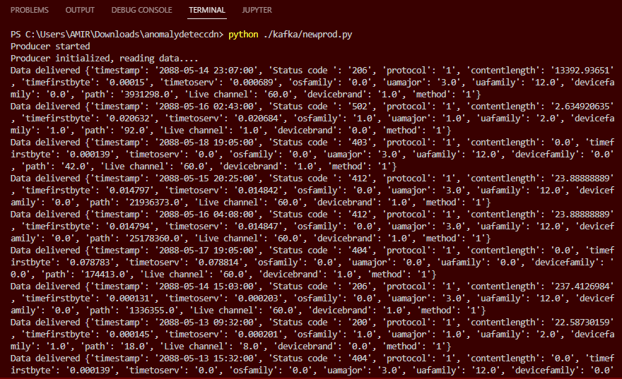
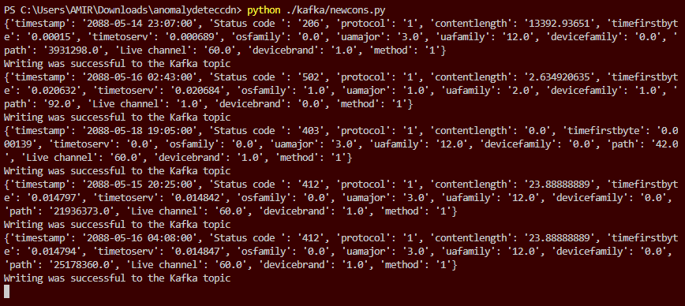
Apache Kafka implementation
Producer running and sending to a kafka topic waiting to be consumed
Consumer reading messages from the stored kafka topic

Slide 12
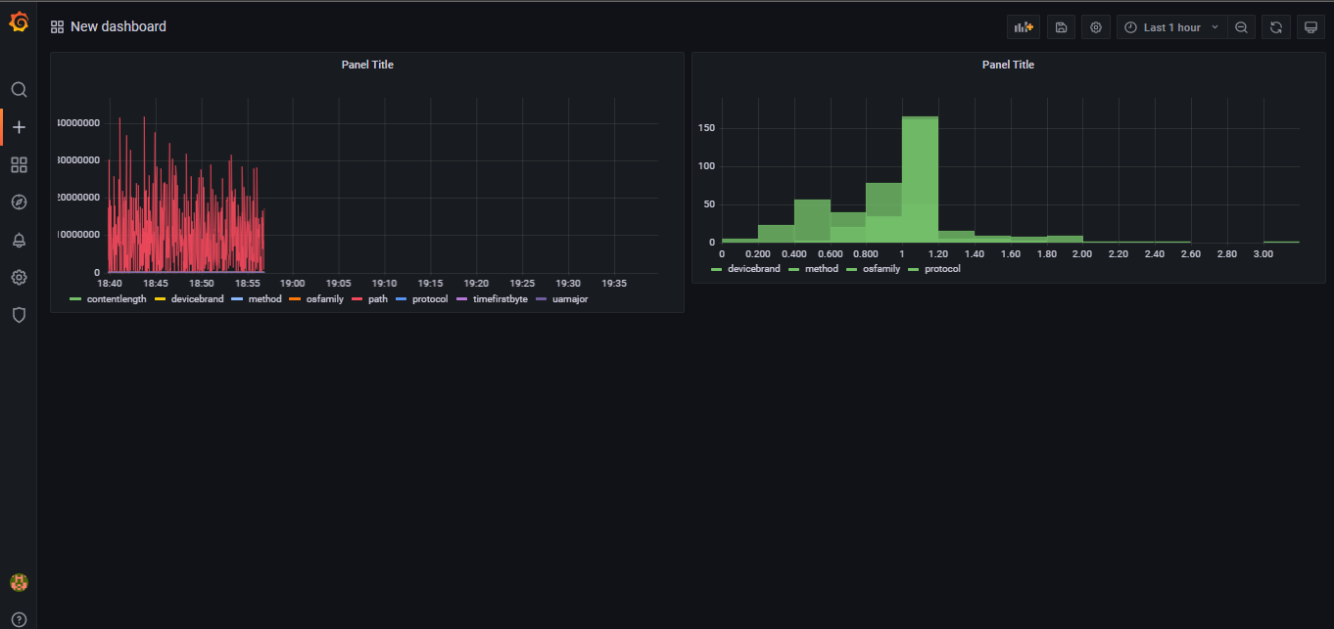
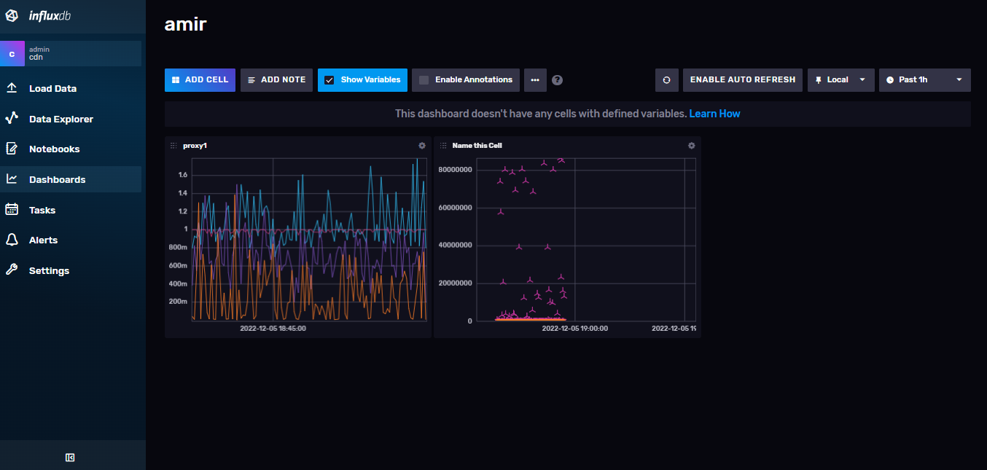
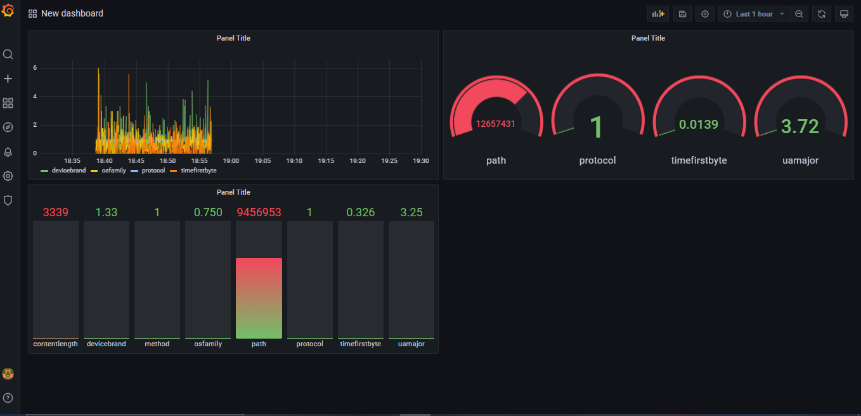
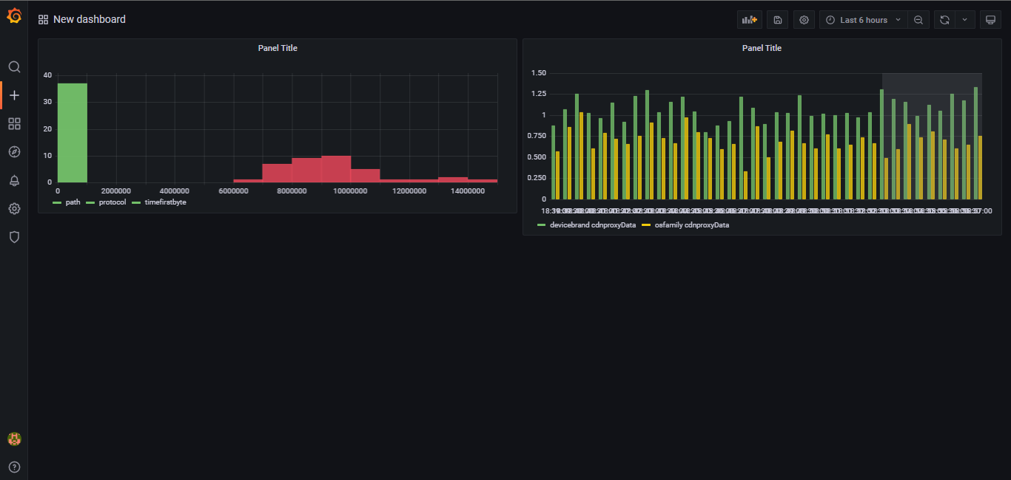
Dashboards and visuals

Slide 13
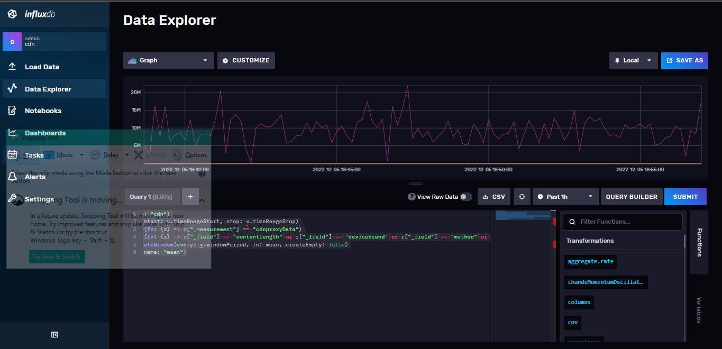
Dashboard

Slide 14
Individual Contributions
 | Inuwa Amir Usman | Aizaz Ali Qureshi | Arzu Tosayeva
 | Implementation of Kafka,influxDb, telegraf, creating visualizations | Spark batch Preprocessing, upload the data to influx dB, creating visualizations | Data Preprocessing, Implementation of LSTM Autoencoder, creating visualizations

Slide 15




Thank you

